Slide 1

Data Analysis Report
Skincare Advisor analytical insights

Slide 2
Overall engagement
The skincare advisor solution received a total of 103,000 interactions from January to December 2020, with the highest engagement observed in the last quarter of the year (48,000 interactions). This suggests that users are finding the solution useful and engaging.

Slide 3
User completion rate
The completion rate of the flow to receive relevant product recommendations varied across different quarters, with the highest completion rate observed in the fourth quarter (42.61%). The skincare brand may want to investigate why completion rates are lower in other quarters and see if any adjustments can be made to improve the user experience and encourage users to complete the flow.

Slide 4
More info clicks
The number of clicks on the "More info" button is relatively high (23,795), which suggests that users may be looking for more information on the recommended products. The skincare brand should consider providing more detailed product information, such as ingredients and benefits, to help users make informed purchasing decisions.

Slide 5
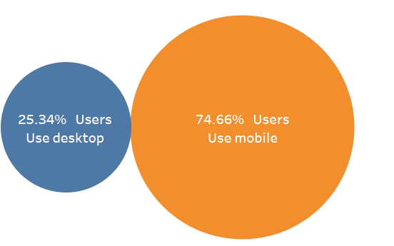
Mobile vs desktop
In the second half of the year, more users interacted with the solution on mobile devices (48,900) compared to desktop devices (16,600). This highlights the importance of optimizing the solution for mobile devices.
The skincare brand should consider conducting user testing on mobile devices to identify any usability issues and make adjustments accordingly.

Slide 6
Selfie Taken
The selfie feature was used by a total of 40,825 users in the second half of the year, with the highest usage (31,200) observed in the fourth quarter. This suggests that the selfie feature is a popular and useful addition to the solution.

